Slide 1
Rear Upright CDR
Mike Ornstein
11/6/2012

Slide 2
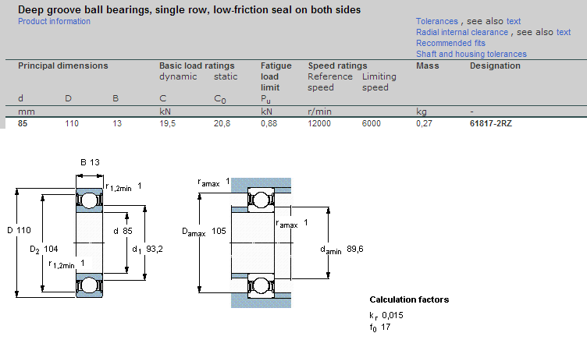
Bearing Selection: Prime Option
SKF 61817-2RZ (85mm bore, 0.27kg (0.15kg in front) – 0.59lb)
Deep groove

Slide 3
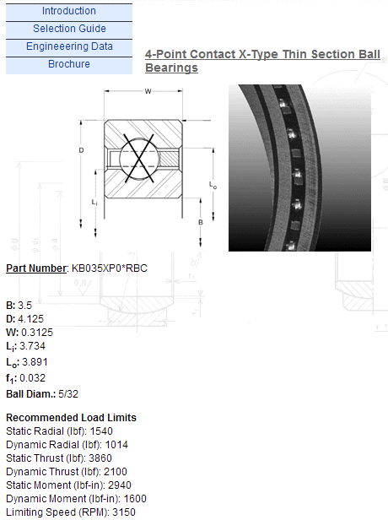
Bearing Selection: Alt Option
KB035XP0*RBC (3.5” bore, 0.27lb)
X-type Thin Section

Slide 4
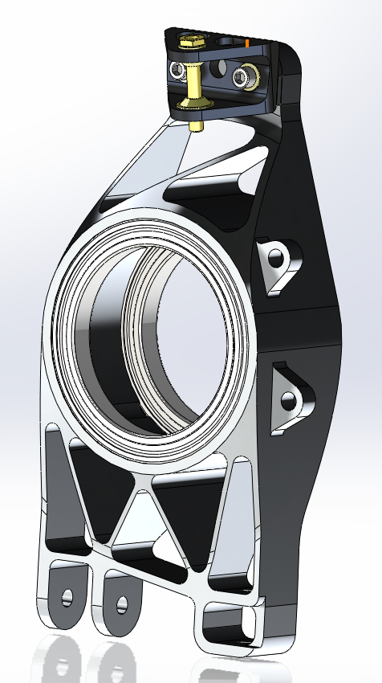
Solid Model
Rear: 2.06lbs
Front: 2.18lbs
Old: 1.85lbs

Slide 5
Engineering Drawing
Coming Soon

Slide 6
General Modeling Conditions
Cases:
Turning (max lateral g -> normal/lateral patch loads)
Braking (max braking forces)
Model:
Element size 0.1”, bearings bonded to upright
Spherical joints at all real life places
Deflections include Suspension Links

Slide 7
Turning
Forces applied at contact patch
Peak normal load from load transfer
Peak lateral load from max cornering
12.5ksi peak stress (at clevis fillet)
0.02 deg toe change
0.01 deg camber change

Slide 8
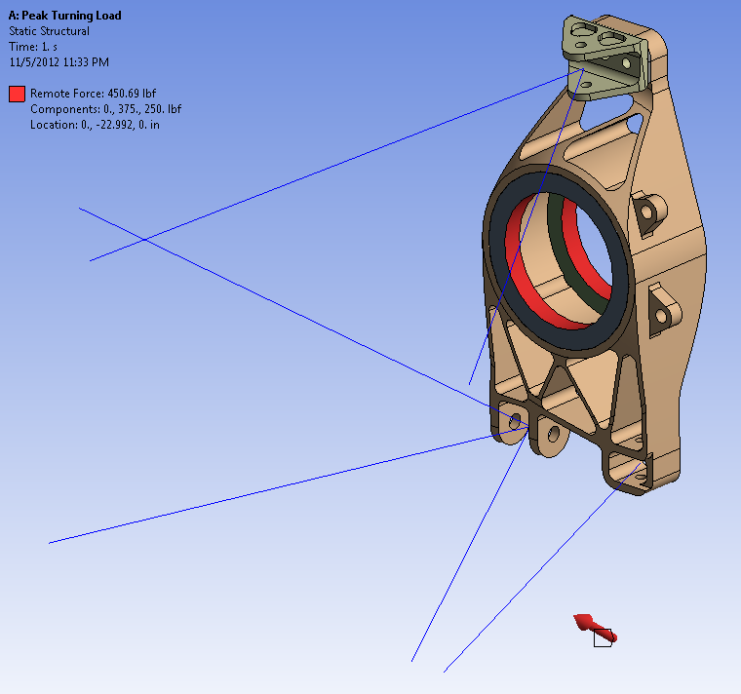

Slide 9
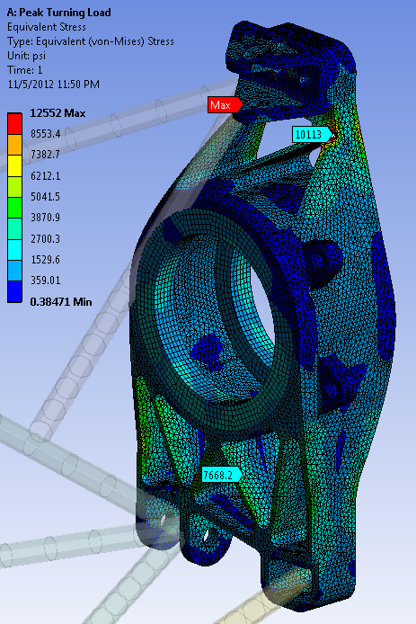
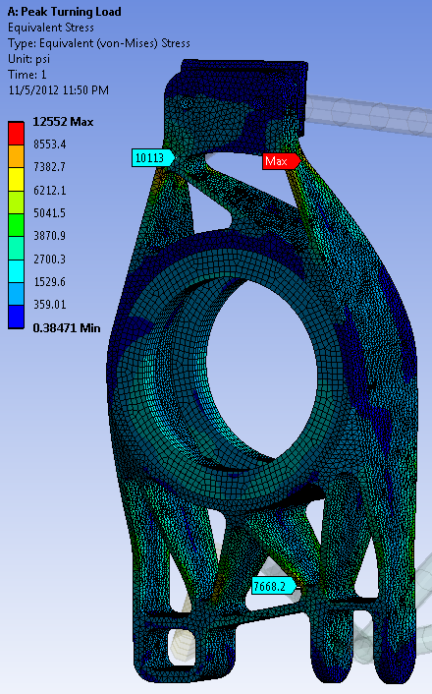

Slide 10
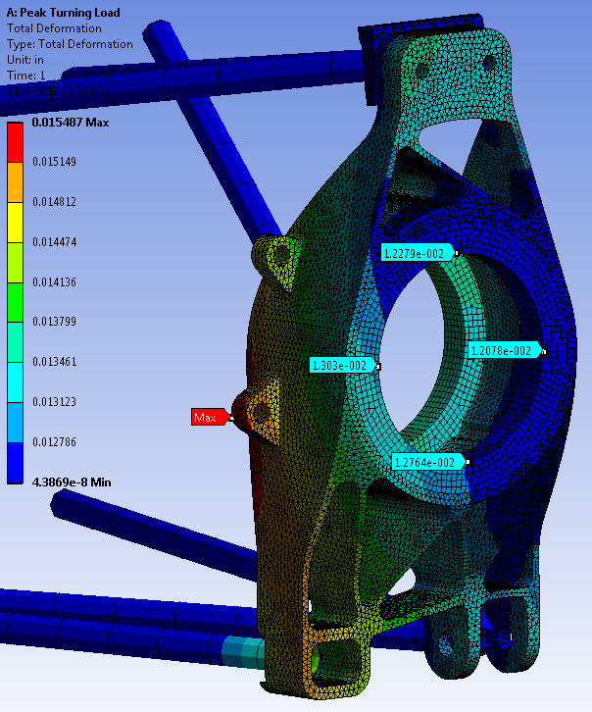

Slide 11
Braking
Peak forces experienced during braking
Longitudinal due to contact patch friction
Caliper on Upright
Spindle reaction on Upright from Caliper
16.5ksi peak stress (at lower a-arm pickup)
0.28 deg toe change
Due to soft toe link
0.02 deg camber change

Slide 12
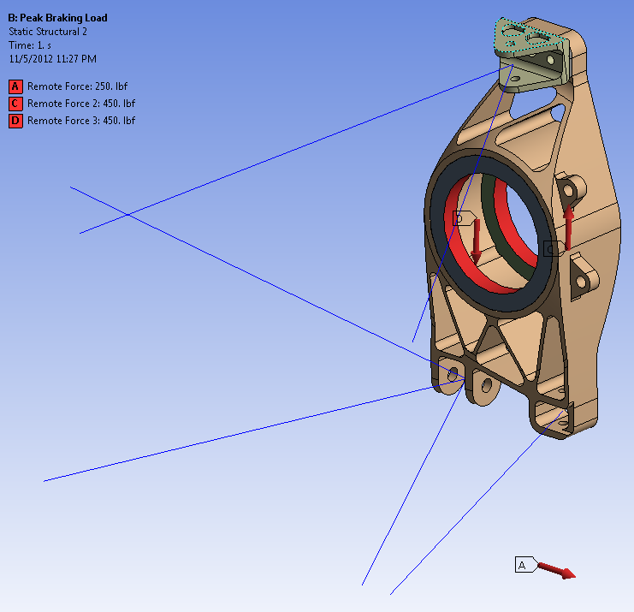

Slide 13
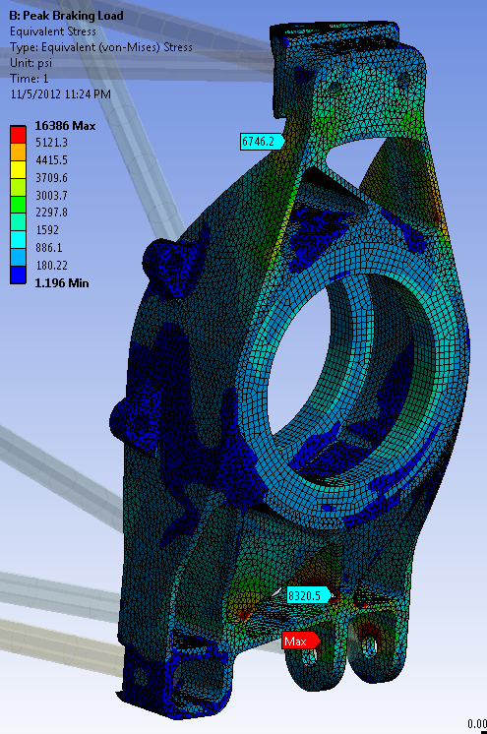
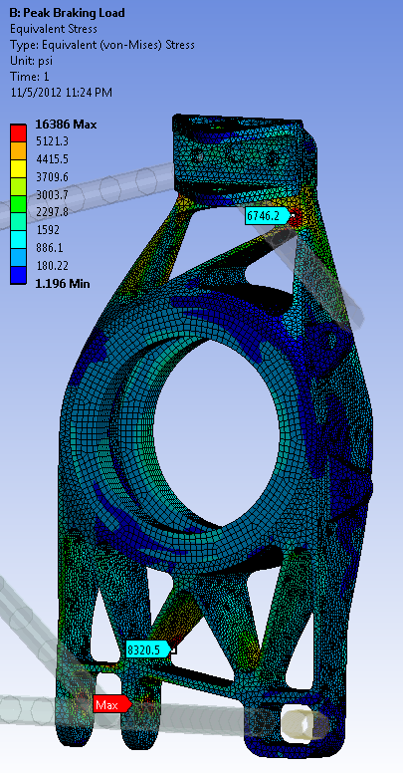

Slide 14
